Slide 1
Ubuntu 17.10 online upgrade to 18.04
Home Folder Encryption – ecryptfs
(Part 2)
Waikato Linux User Group
Ian Stewart
24 Sep 2018

Slide 2
Introduction
Steps:
Upgrade 17.10 with latest patches.
Perform online upgrade to 18.04.1
Log into “ian” and see if “aurora” still has encryption.
Create “james” account with encryption.
Log into “james” account for the first time.
From ian account on HDD try decrypting all accounts.
Boot USB 18.04 / Live CD and try decrypting all acounts.

Slide 3
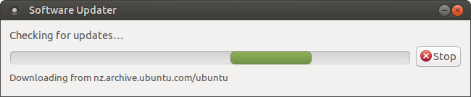
Update Ubuntu Mate 17.10

Slide 4
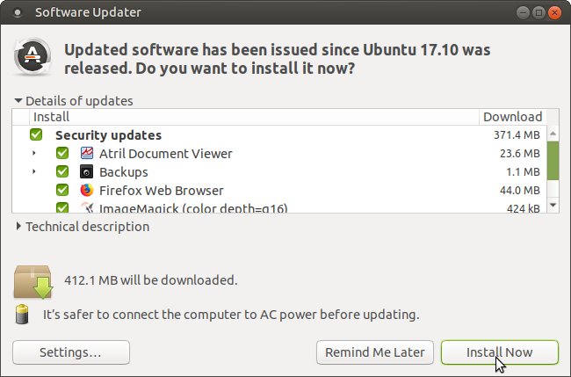
Update Ubuntu Mate 17.10
Need to get 17.10 up-to-date before upgrading to 18.04

Slide 5
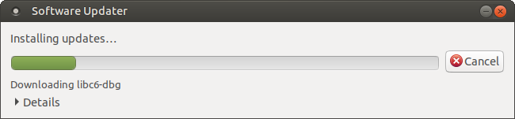
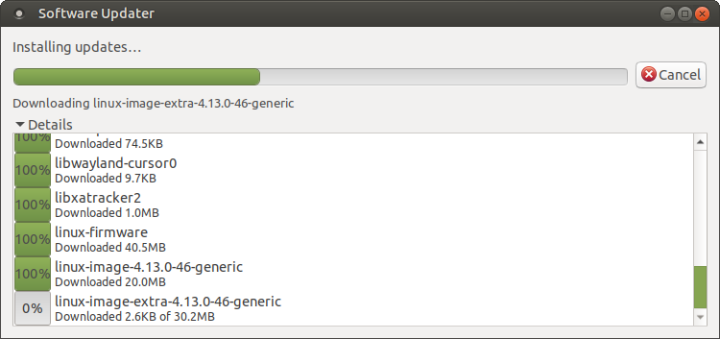
Update Ubuntu Mate 17.10
Need to get 17.10 up-to-date before upgrading to 18.04

Slide 6
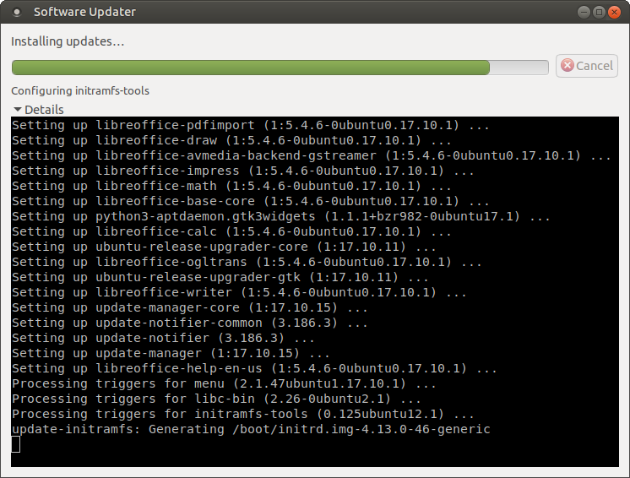
Update Ubuntu Mate 17.10
Need to get 17.10 up-to-date before upgrading to 18.04

Slide 7
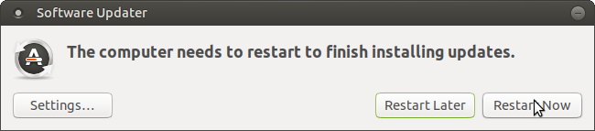
Update Ubuntu Mate 17.10
Need to get 17.10 up-to-date before upgrading to 18.04

Slide 8
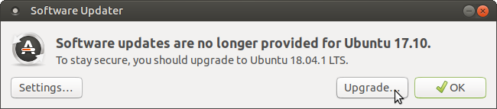
Check for Updates Again
Prompted to upgrade to 18.04.1

Slide 9
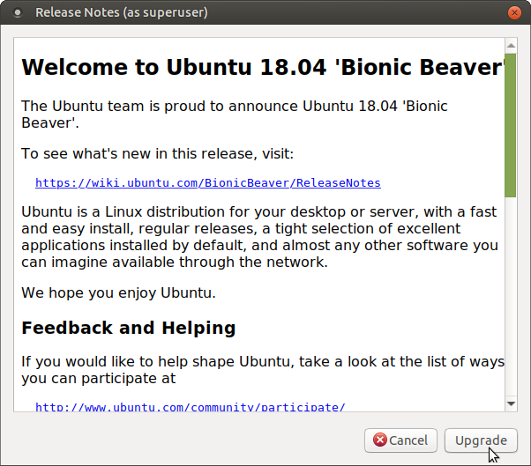
Commence upgrade to 18.04.1

Slide 10
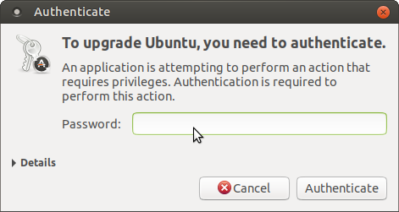
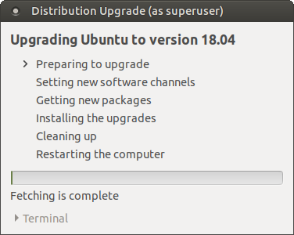
Upgrading to 18.04.1

Slide 11
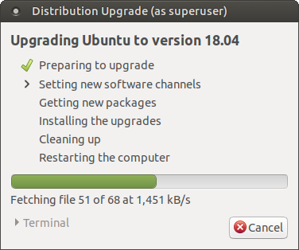
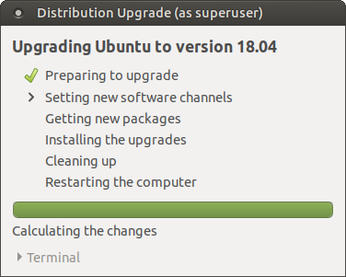
Upgrading to 18.04.1

Slide 12
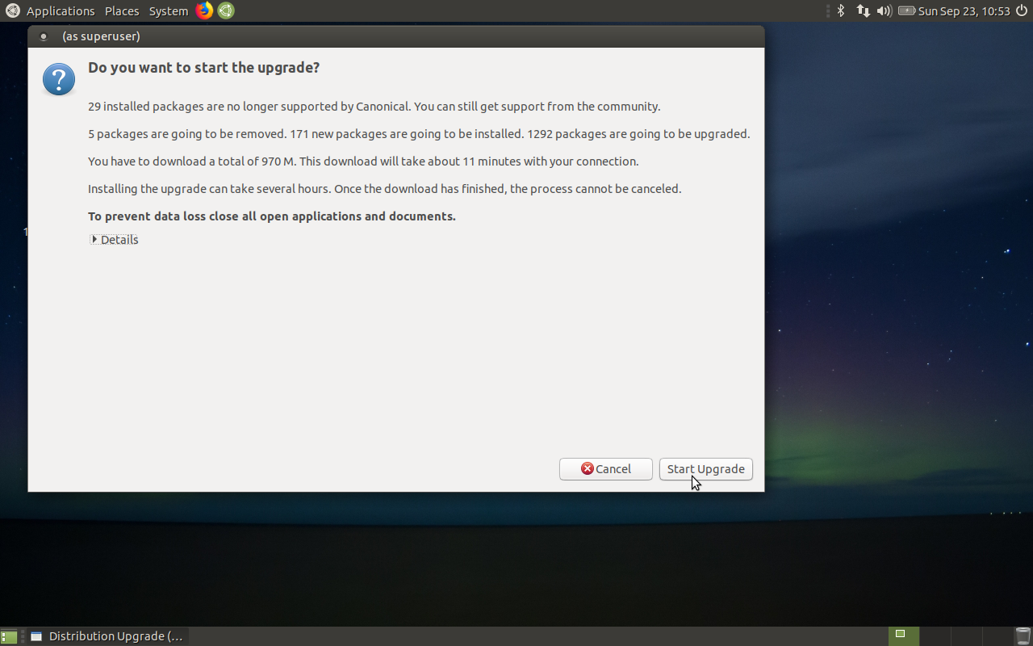
Upgrading to 18.04.1 – Don’t click >Details / No Buttons

Slide 13
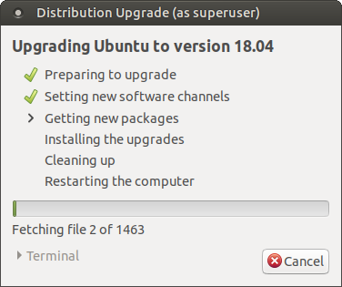
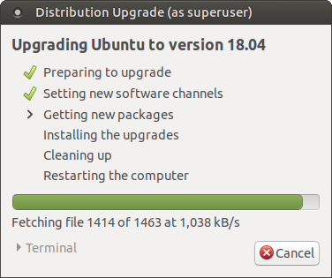
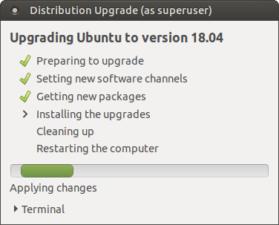
Performing upgrading to 18.04.1

Slide 14
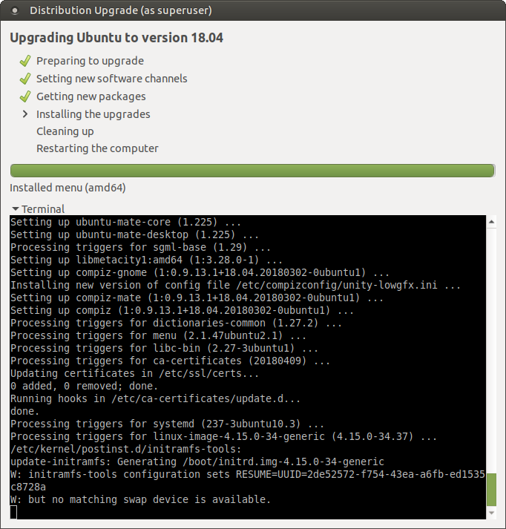
Performing upgrading to 18.04.1
Display Terminal
Note:
W: but no matching swap device is available.

Slide 15
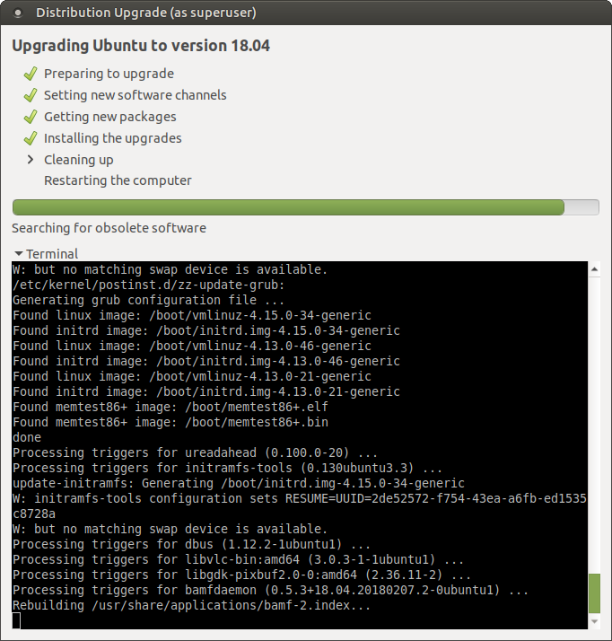
Performing upgrading to 18.04.1
Display Terminal
Note:
Linux 4.15.0-34 is latest as of 24/9/18 for ubuntu
Linux Kernel, as of 24/9/18, is 4.18.9

Slide 16
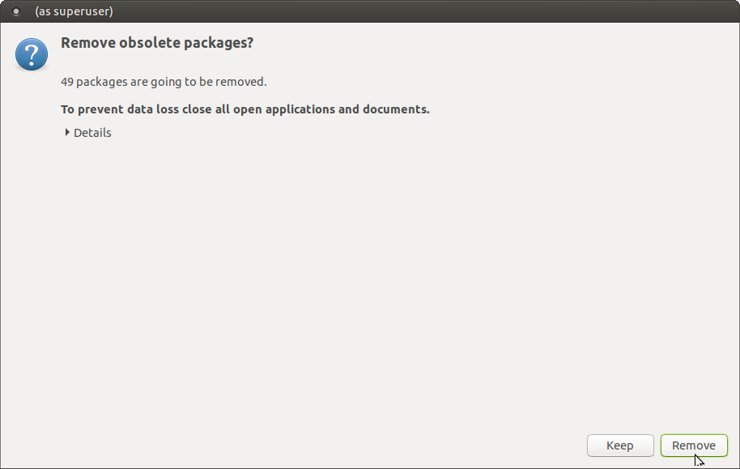
Performing upgrading to 18.04.1

Slide 17
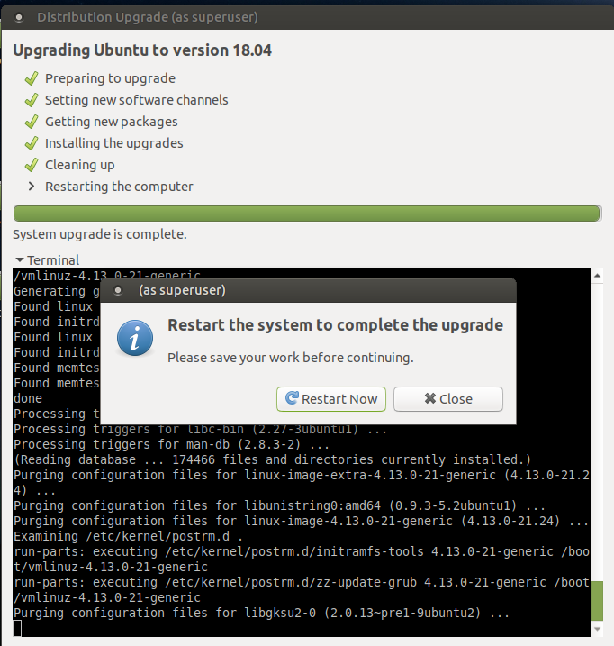
Upgrade to 18.04.1 complete. Reboot

Slide 18
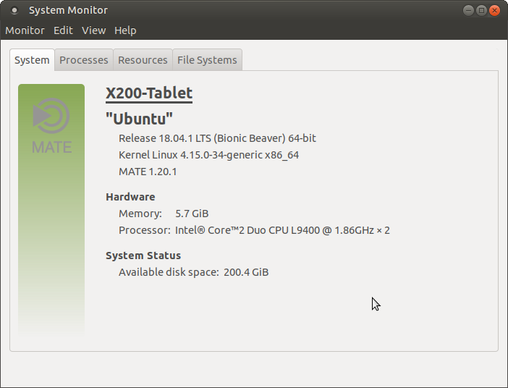
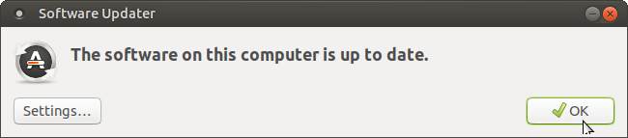
After Rebooting

Slide 19
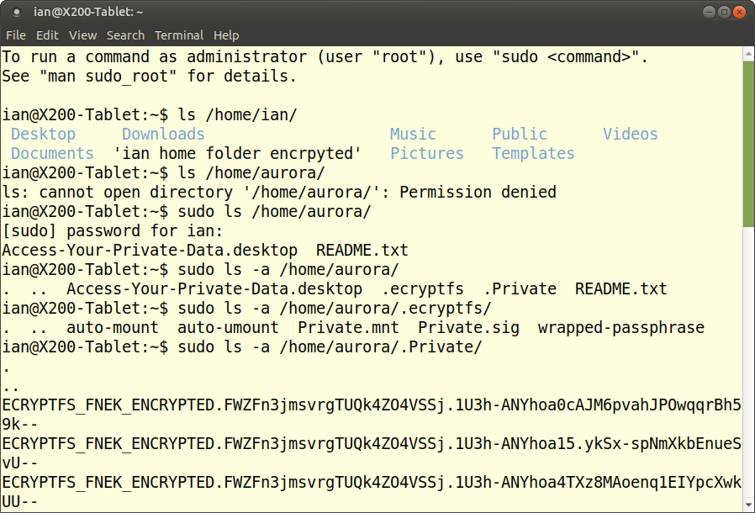
From ian account.
Aurora still encrypted

Slide 20
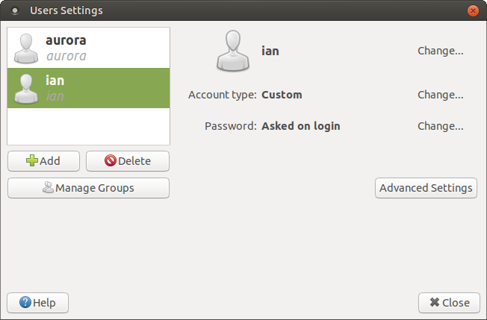
Create a new User account

Slide 21
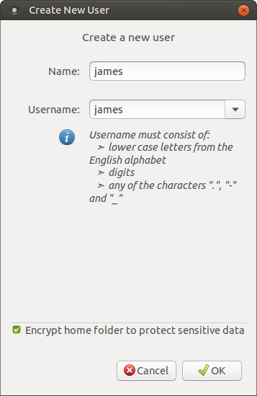
Create account for “james”
Note:
Can check “Encrypt home folder to protect sensitive data

Slide 22
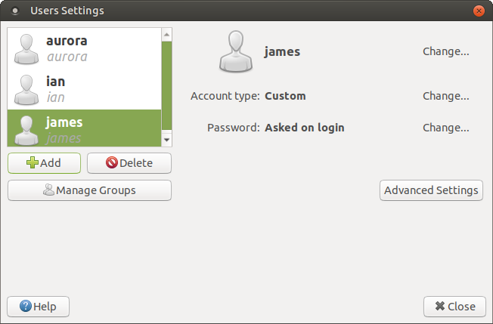
Now have 3 x encrypted accounts

Slide 23
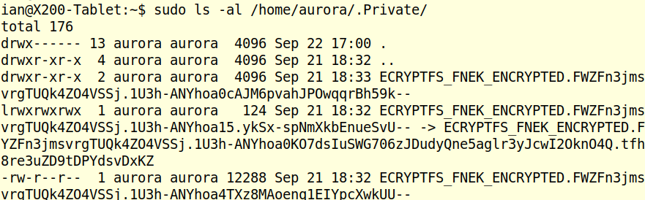
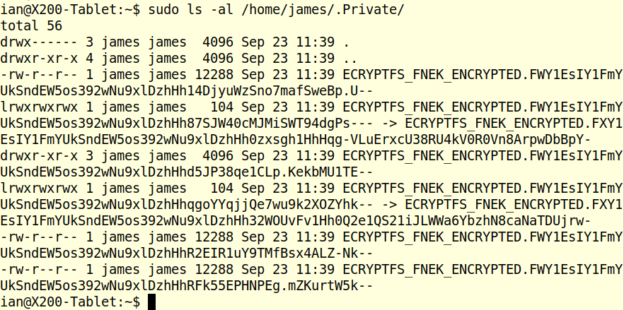
Observe aurora and james are both encrypted

Slide 24
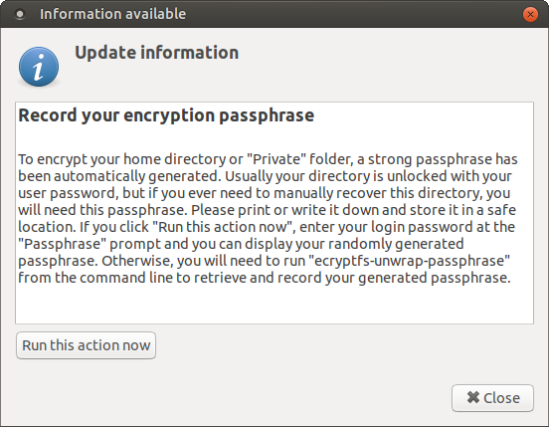
First time logging into “james”

Slide 25
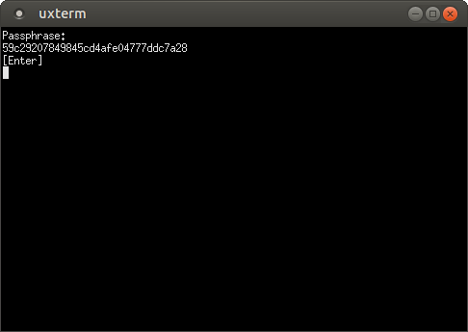

First time logging into “james”

Slide 26
Now lets see if home folders can be decrypted...
Summary – so far...
On-line upgrade to 18.04 preserves ecryptfs home folder encryption.
GUI utility to Add New User Account provides enabling the new account with encryption.

Slide 27
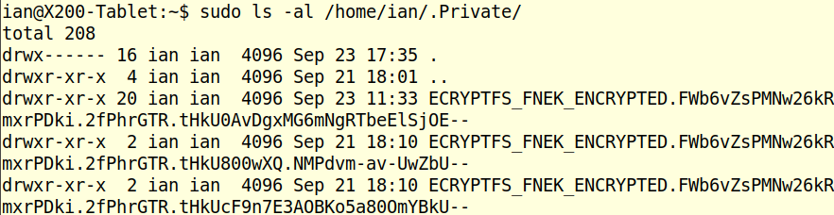
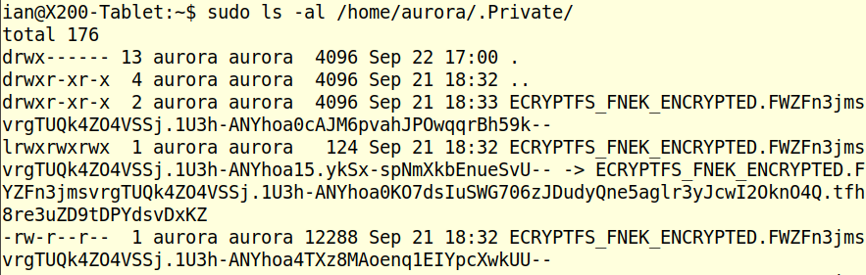
Check for the encrypted folder and files...

Slide 28
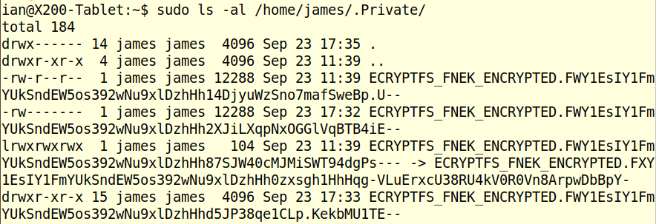
Check for the encrypted folder and files...

Slide 29
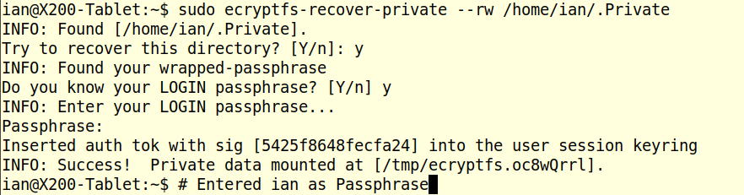
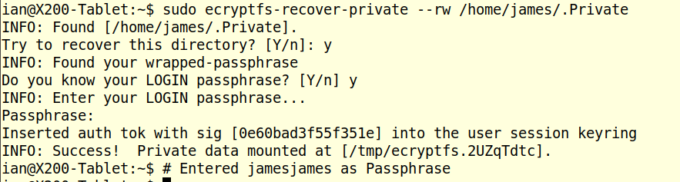
Use ecryptfs-recover-private to decrypt to /tmp/...

Slide 30
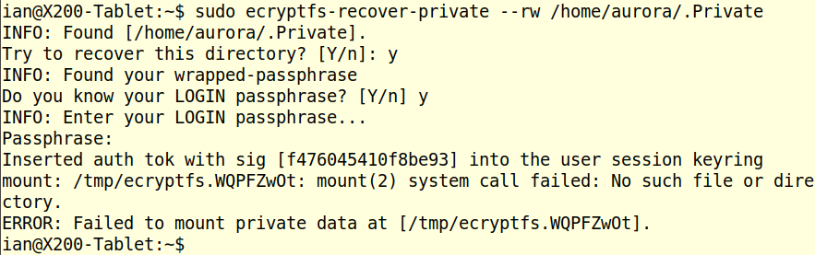
Use ecryptfs-recover-private to decrypt to /tmp/... whoops!

Slide 31
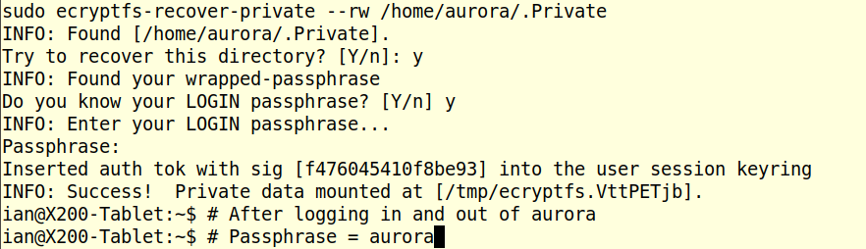
Actions that “fix” aurora account...
Log out of ian,
log into aurora,
issue a ecryptfs-unwrap-passphase
log out aurora
log into ian,
Use ecryptfs-recover-private to decrypt to /tmp/....

Slide 32
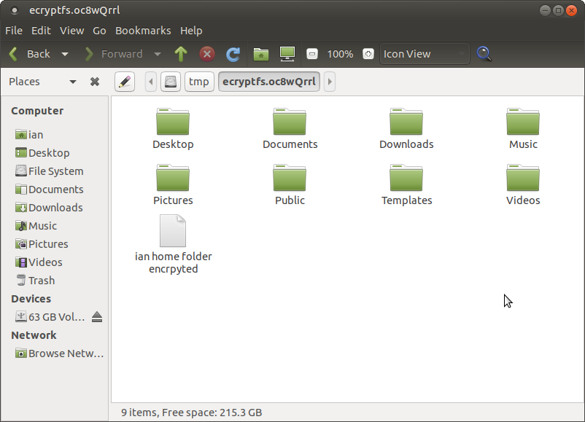
Check the /tmp/ decrypted folder and files exist. ian

Slide 33
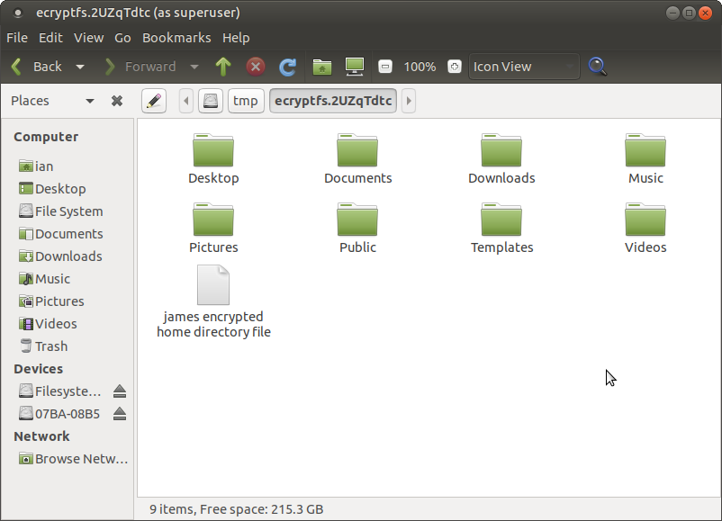
Check the /tmp/ decrypted folder and files exist. james.

Slide 34
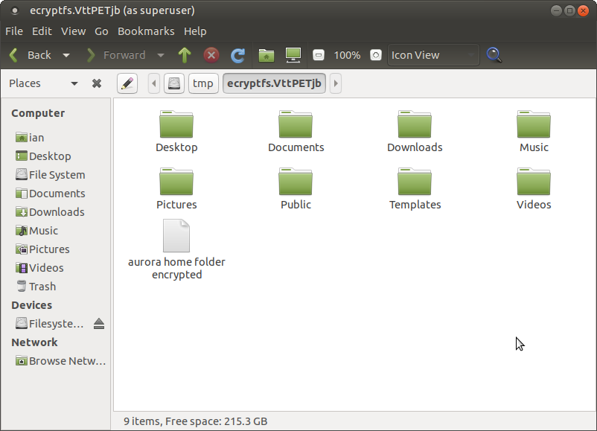
Check the /tmp/ decrypted folder and files exist. aurora

Slide 35
Now lets boot a 18.04 USB stick / Live CD and see if decryption is possible...
Summary – continued...
Using ian account on the 18.04.1 HDD able to decrypt the files and folders of ian (although not necessary), aurora and james
Bit of a glitch with aurora, but it came right.

Slide 36
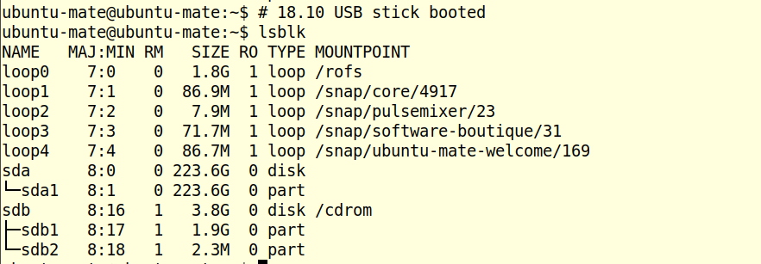
After booting 18.04.1 USB stick
233GB sda1 partition needs to be mounted

Slide 37
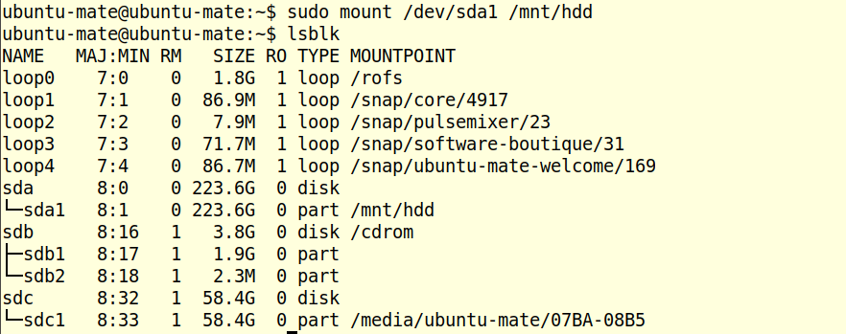
Mounted sda1 as /mnt/hdd

Slide 38
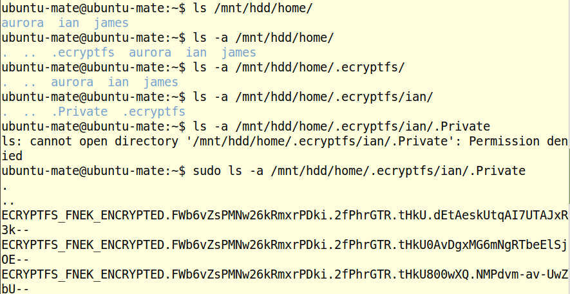
Check the folders/files exist and are encrypted

Slide 39
Now try ecryptfs-recover-private to decrypt ian...
Whoops! command not found!...
18.04 distro does not include ecryptfs!!!

Slide 40
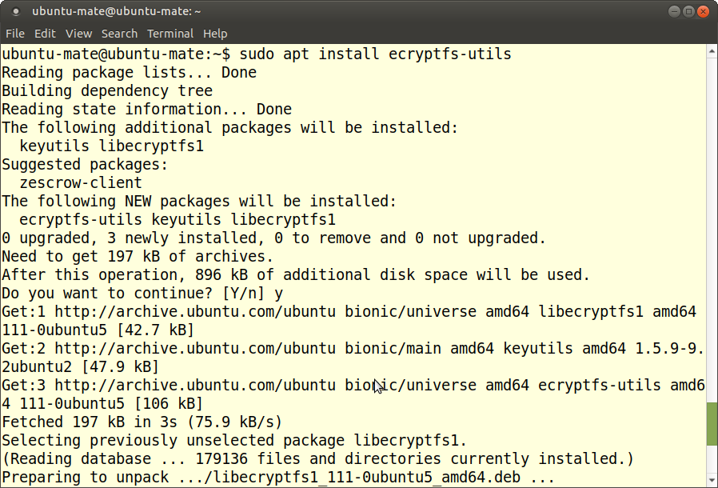
Install ecryptfs-utils (1/2)...

Slide 41
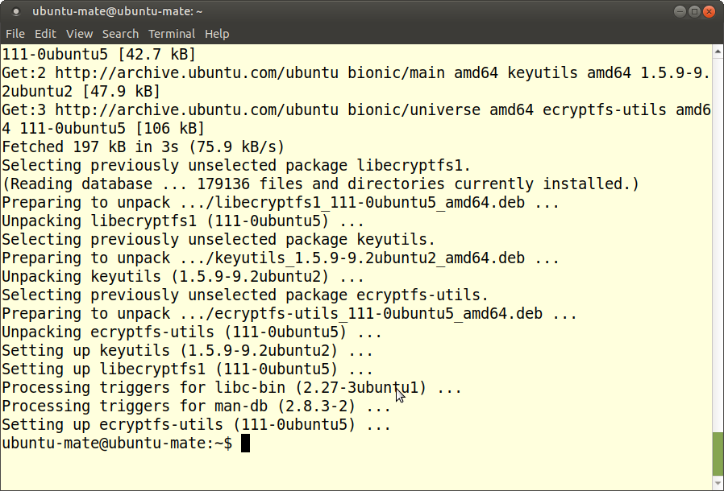
Install ecryptfs-utils (2/2)...

Slide 42
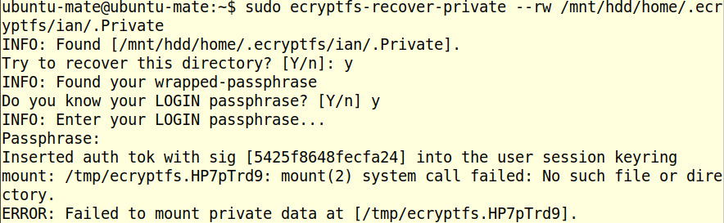
Try again...
Hmmm, this again. Fails for ian, aurora and james..

Slide 43
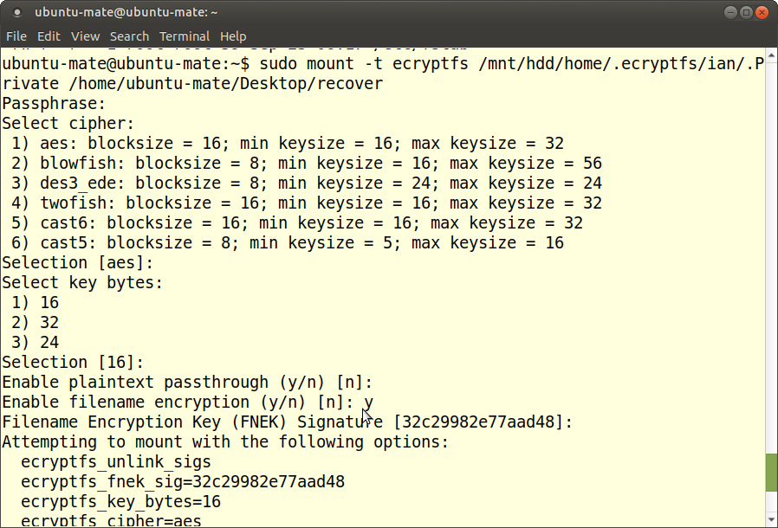
Give this another go (1/2)...

Slide 44
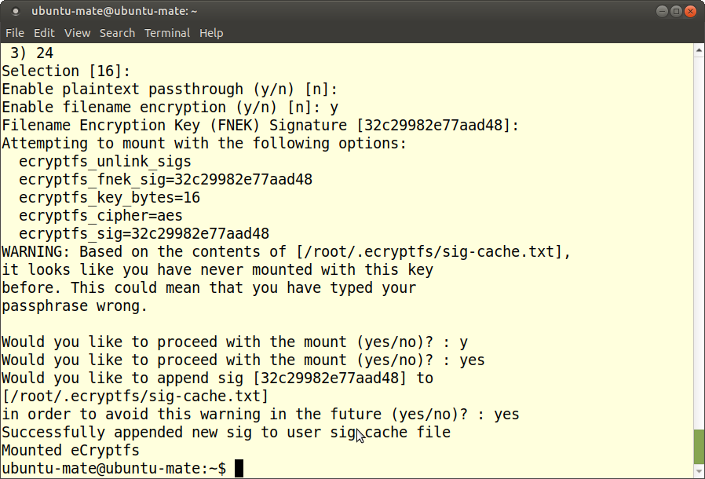
Give this another go (2/2)...

Slide 45
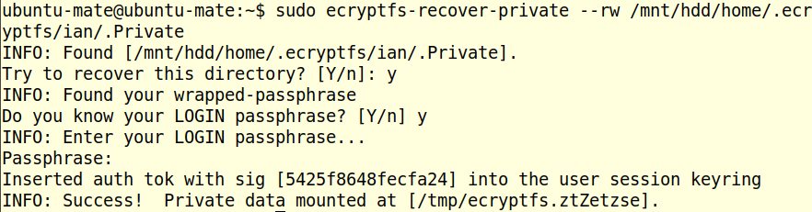
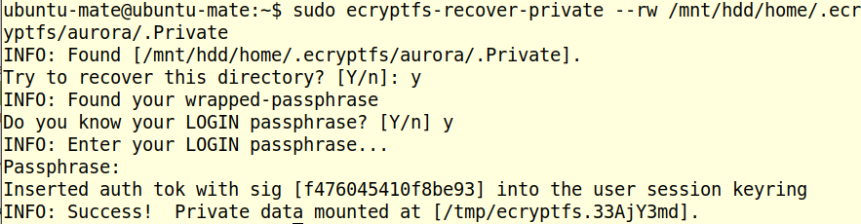
Now re-try the ecryptfs-recover-private (1/2)...

Slide 46

Now re-try the ecryptfs-recover-private (2/2)...

Slide 47

Check that decrypted folders and files are available...

Slide 48

Check that decrypted folders and files are available...

Slide 49

Check that decrypted folders and files are available...

Slide 50
Summary – continued...
18.04 distro does not include ecryptfs.
Go online use apt to install ecryptfs-utils.
ecryptfs-recover-private fails.
Run bug-work-around: $ mount -t ecryptfs.
ecryptfs-recover-private now decrypts all accounts.

Slide 51
End

